Slide 1
Soru - 1
How many address lines and input – output data lines are needed in each case, also give the capasity of ram.
a) 16K x 64
b) 1M x 32
c) 128M x 16
d) 4G x 8

Slide 2
Soru -2
An integrated circuit RAM has capacity 128K x 4,
How many address and data lines
How many chips are needed for 512Kx16
Draw a block diagram

Slide 3
Soru - 3
Design 4 bit priority encoder with both PLA/PAL.
Minimize number of product terms, mark fuses.

Slide 4
Soru - 4
Design four bit arithmetic circuit with two selection variables S1 S0 that generates the following arithmetic operations. Draw the logic diagram of two typical stage.
S1 | S0 | Cin = 0 | Cin = 1
0 | 0 | G = A + B | G = A + B + 1
0 | 1 | G = A | G = A + 1
1 | 0 | G = A - 1 | G = A + B’ + 1
1 | 1 | G = B – 1 | G = B + 1

Slide 5
Soru - 5
A 3 bit counter determines its next state by following rule:
Next state count = (current state count + 3) mod 5
Where mod is remainder operatör.
İnitial state is 010 use C = C2C1C0 C2 is most significant.
Draw state diagram
İmplement the above counter using circuit of minumum size using 3 T flip flops. Dont care unused states, do not draw circuit
Analyze self correcting property

Slide 6
Soru – 6
Assume that the data path described in Figure 1 uses unsigned magnitude representation and has 8 4-bit registers. Initially each register contains value of its number. The following sequence of 17 bit control words that presented datapath.
For each, identify the micro-operation that is executed,
Show the new contents of each destination register through the sequential execution of each micro-operation

Slide 7
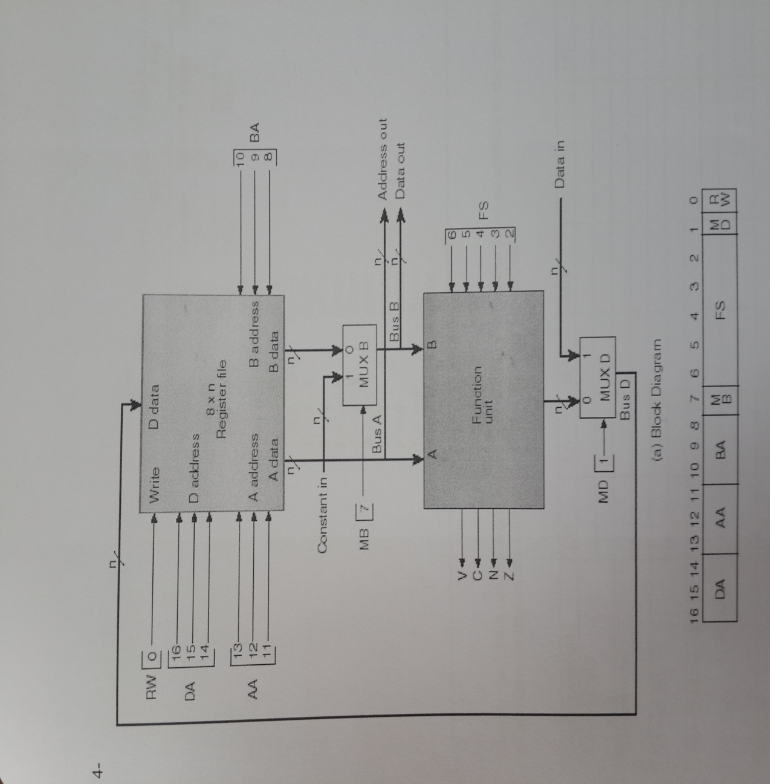
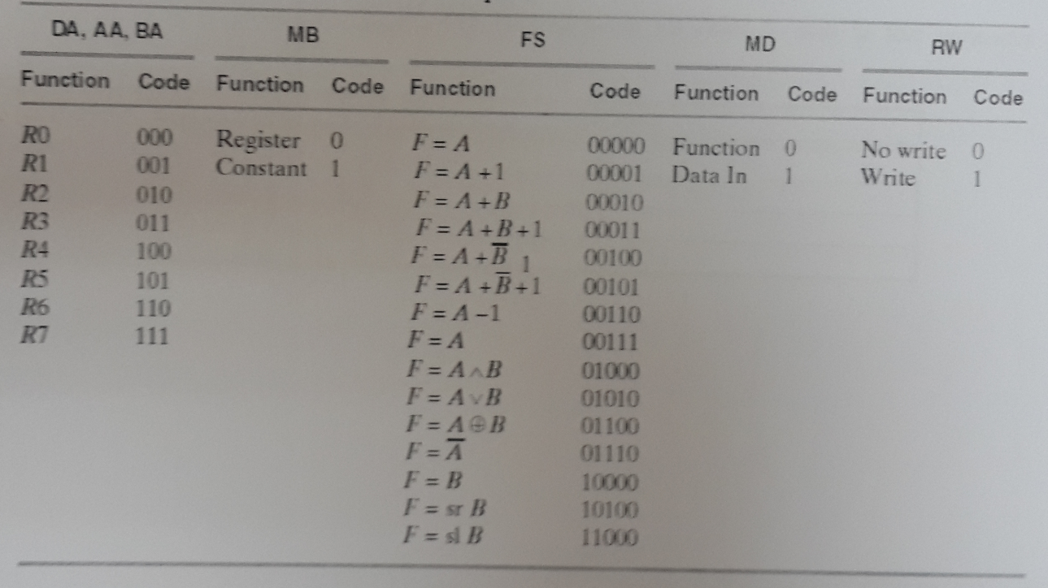
Soru – 6 Devam

Slide 8
Soru - 7
Aşağıda pseudo kodu verilen algoritmayı gerçekleyebilen en küçük veri yolunu tasarlayınız? Devrede bulunan kontrol bitlerini verilen tablodaki sütunlara yazarak her bir işlem için alacağı değerleri yazınız?
Tasarımda bir adet toplayıcı/çıkarıcı ve yeteri kadar çoğullayıcı (mux), saklayıcı ve temel lojik kapılarını kullanınız.
X = 0
Y = 4
input Z
while (Z ≠ 0) {
X = X+Y
Z = Z-1 }

Slide 9
Soru – 7 Çözüm

